Slide 1



MET CS777
Big Data Analytics
Term Paper
1
Analyzing and Visualizing Big Data Performance in the Cloud
Google BigQuery vs. Databricks Spark SQL
Group-21
Tanvi Thopte-U35489362
Mehul Bisht-U93099406

Slide 2

2
Introduction: Cloud Analytics for Ecommerce Big Data
Project Goal
To evaluate and compare the performance and visualization efficiency of Google BigQuery (serverless) and Databricks Spark SQL (cluster-based) for cloud-based big data analytics on an e-commerce dataset, focusing on query execution time, scalability, and insight visualization using looker studio and python.
Importance of E-commerce
E-commerce is one of the largest data-generating industries today, offering real-time insights into customer behavior and sales trends. It helps businesses optimize pricing, marketing, and inventory through data analytics. Studying e-commerce data demonstrates how big data tools handle large, dynamic, and transaction-heavy datasets effectively.

Slide 3

3
Platform Genesis
Both BigQuery and Databricks emerged from the need to manage and query massive datasets efficiently using distributed computing paradigms.
2011: Google BigQuery Launch
Introduced by Google as a serverless, highly scalable, and cost-effective enterprise data warehouse running on the Dremel engine.
2013: Databricks Founding
Founded by the creators of Apache Spark. Focused on unifying data engineering, data science, and machine learning workloads on a single platform.
Modern Distributed Analytics
Both platforms have evolved to become central components in modern cloud data architectures, offering petabyte-scale analysis capabilities.

Slide 4





4
Technology Overview and Architectural Comparison
Serverless Dremel SQL engine
Clustered Spark
execution
Google
Big
Query
Data
Bricks
Separated storage and compute
In-memory distributed compute
Engine: Dremel (SQL-based MPP).
Engine: Apache Spark (unified analytics engine).
Architecture: Serverless; computation and storage are separated.
Architecture: Cluster-based; requires cluster configuration and management.
Data Storage: Columnar storage for optimized analytical queries.
Data Storage: Uses Delta Lake, transactional data layer; in-memory processing.
Key Benefit: Zero-management and automatic scaling.
Key Benefit: High flexibility and control over compute resources.

Slide 5

5
Primary Use Cases and Application Focus
BigQuery:
Great for fast data analysis and dashboards.
Fully managed, so you don’t need to worry about servers, you just write SQL and get results quickly.
Used for :
Analyzing data instantly and find trends
Building interactive dashboards using tools like Looker Studio
Tracking things like sales or inventory performance in real time
Google BigQuery Focus
Ideal for high-speed, interactive analytics, and Business Intelligence (BI) tools. Excellent for dashboards and SQL queries on structured data.
Fast Analytics
Interactive Dashboards (Looker)
Retail Inventory Analysis
Databricks:
Better for handling very large and complex data tasks.
Built on Spark, so it can process and clean data, train ML models, and handle continuous pipelines.
Used for :
Preparing and cleaning big datasets (data engineering)
Building AI or machine learning models
Detecting fraud or predicting customer behavior

Slide 6
6
Dataset Information
“ E-commerce event data (Oct 2019–Apr 2020) ”
The dataset represents 7-month log of online store transactions : user behavior, allowing analysis of purchases, sessions, revenue patterns, and anomalies, basically it has tracked what users bought, when, and for how much, across many brands and categories.
Rows:
Millions of events (each event = one product interaction or purchase)
Columns:
Column Name | Description
event_time | Timestamp of the event (UTC)
event_type | Type of event (e.g., view, purchase)
product_id | Unique ID for each product
category_id | Numeric ID for product category
category_code | Readable category name (e.g., “electronics.smartphone”)
brand | Product brand (e.g., apple, samsung)
price | Product price (float)
user_id | Permanent ID of the user
user_session | Temporary session ID (resets after inactivity

Slide 7




7
Dataset and Experimental Methodology
The Dataset
Dataset: E-commerce event data (Oct 2019–Apr 2020)
Size: Tens of GBs (millions of rows).
Data Ingestion
Pre-processing
Upload to respective cloud storage: GCS (for GBQ) and DBFS (for Databricks).
Standardized cleaning, feature engineering, and type casting were performed identically across both platforms.
Query Execution
Metric Recording
Eight identical, complex analytical SQL queries were executed to capture average performance metrics.
Metrics recorded included query execution time (latency), bytes processed, and platform scalability observed.
Visualization
Visualisation performed using Looker studio and Python

Slide 8

8
SQL Queries
1 — Daily Revenue Trend: Tracks total revenue and orders over time to identify daily sales patterns and peaks.
2 — Category × Brand Aggregation: Analyzes which brand–category pairs generate the highest revenue and sales volume.
3 — User-Level Monetization: Measures total spending, purchase frequency, and average order value per user.
4 — Session Analytics: Evaluates session engagement — number of items and total spend per user session.
5 — Trend + Anomaly Detection: Detects unusual spikes or dips in revenue using a rolling 7-day z-score method.
6 — Scalability Test: Tests how BigQuery and Databricks perform when query size or date range increases.
7 — Top-K Products by Revenue: Identifies the most profitable products contributing highest overall sales.
8 — Brand-Level Outlier Analysis: Detects brands with abnormal revenue fluctuations or inconsistent sales trends.

Slide 9
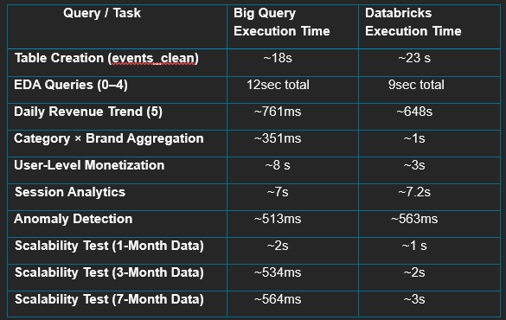
9
Results and Visualization of Query Performance

Slide 10
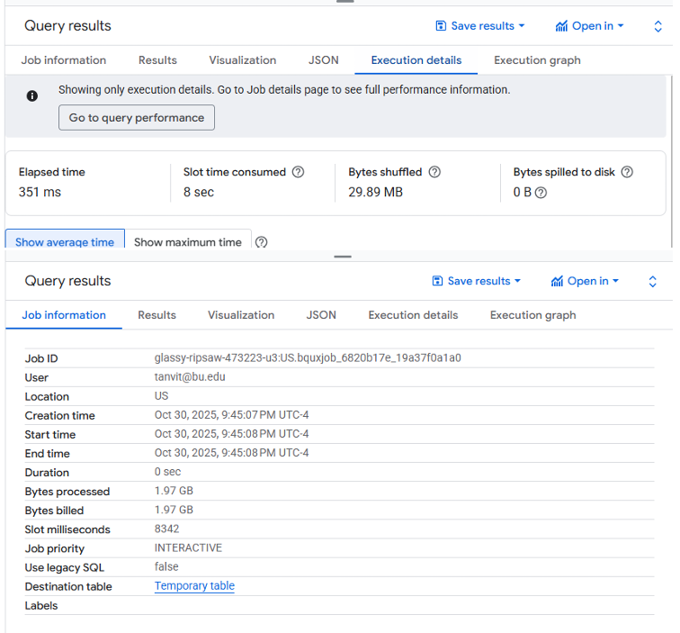
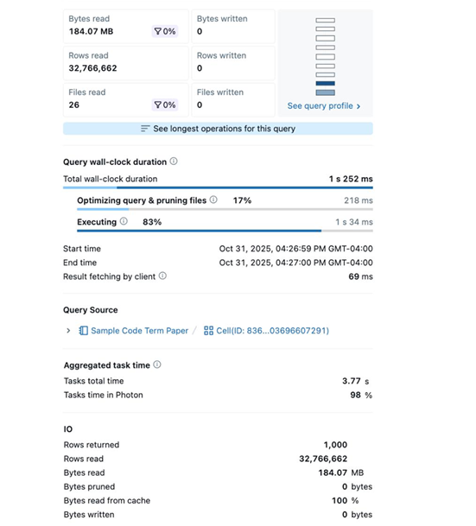
10
Results and Visualization of Query Performance
BigQuery
Databricks

Slide 11
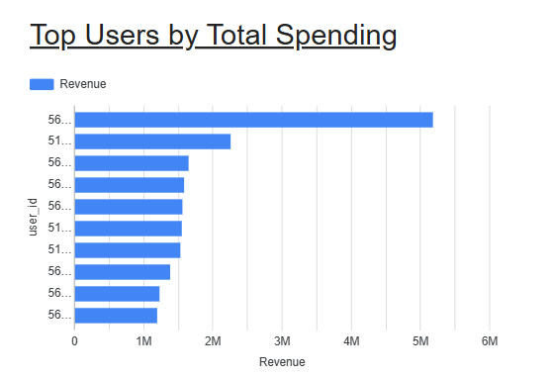
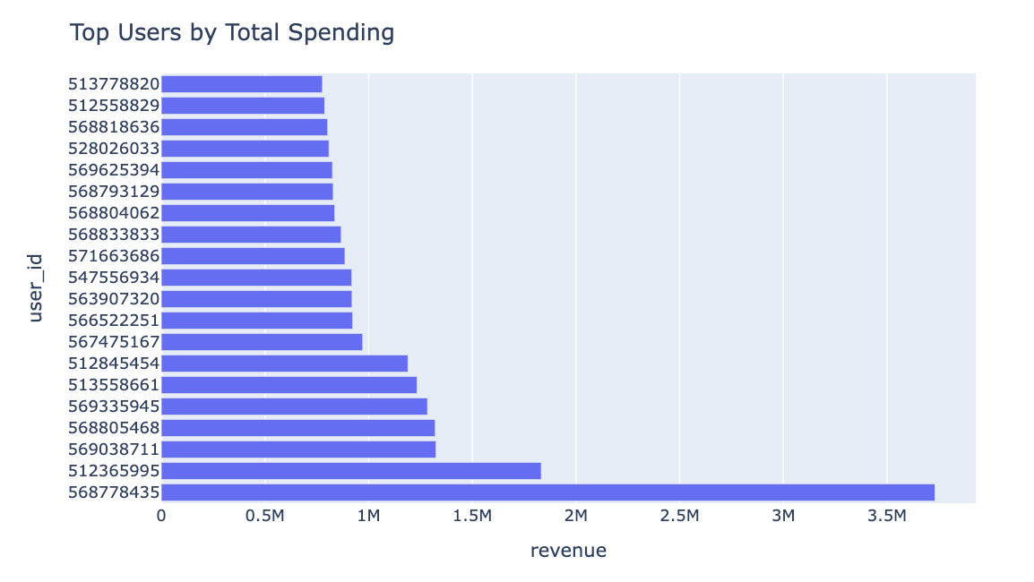
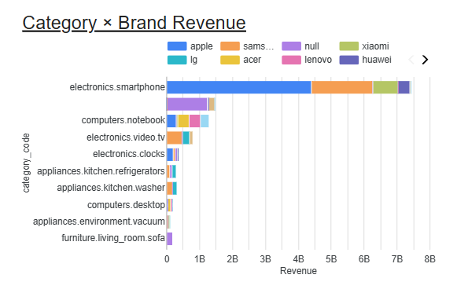
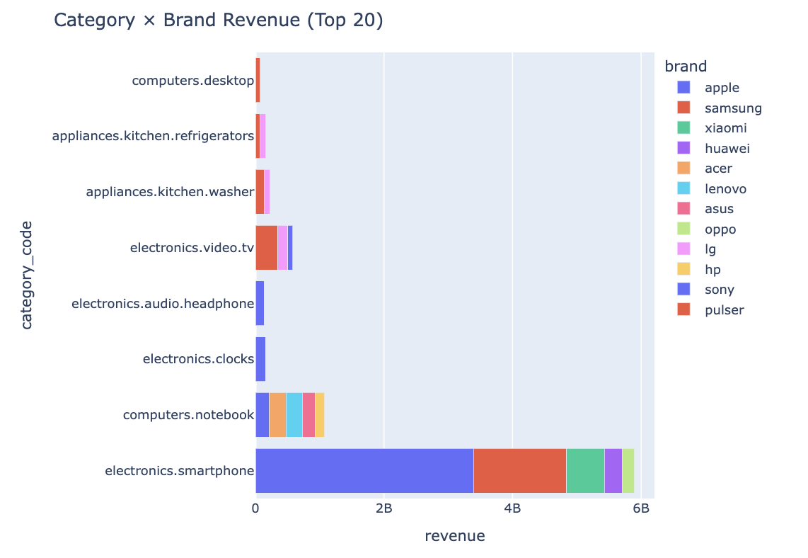
11
Results and Visualization of Query Performance
BigQuery
Databricks
8s
3s
351ms
1s

Slide 12
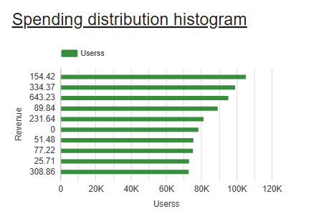
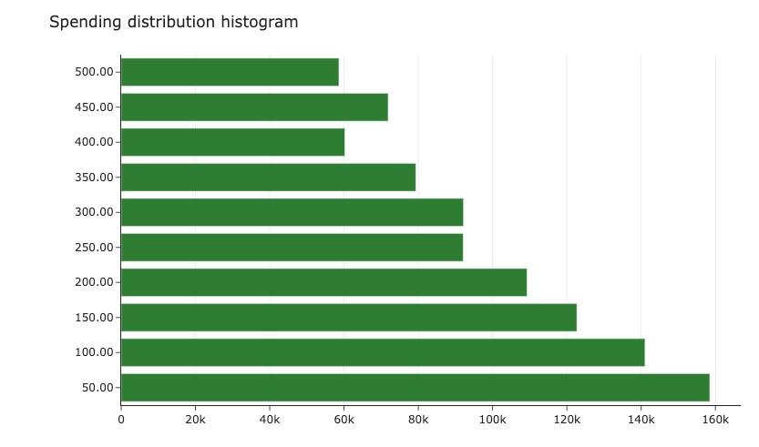
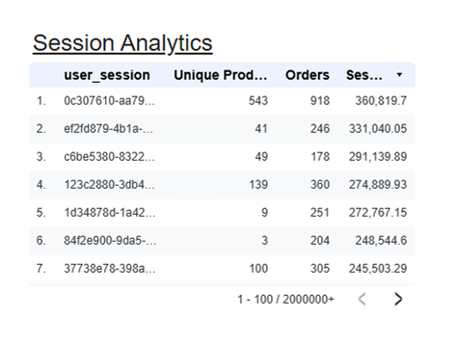
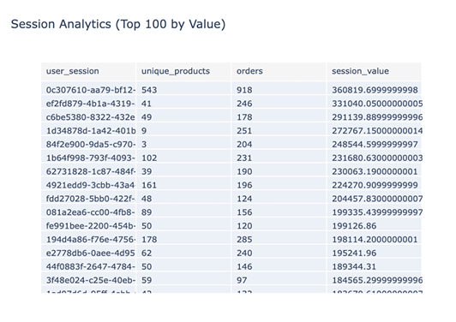
12
Results and Visualization of Query Performance
BigQuery
Databricks
8s
3s
7s
7.2s

Slide 13
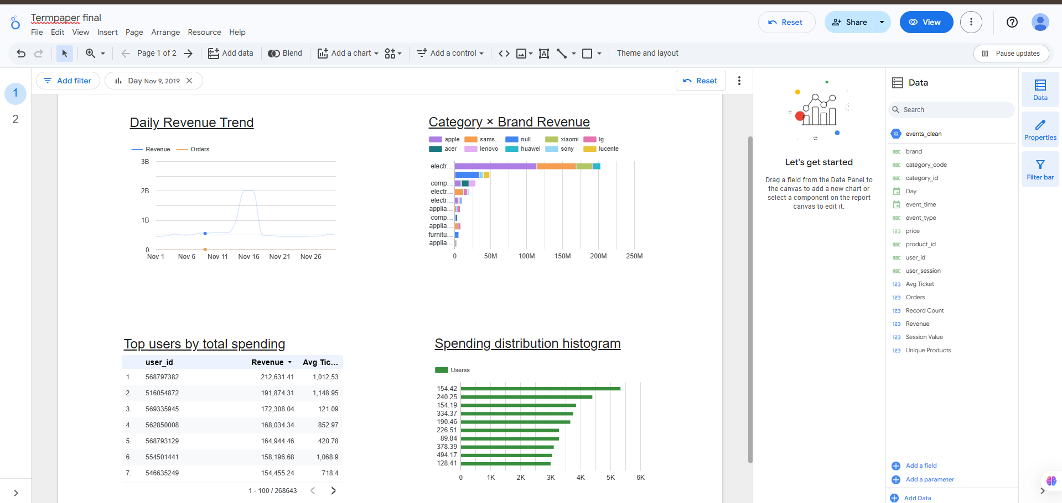
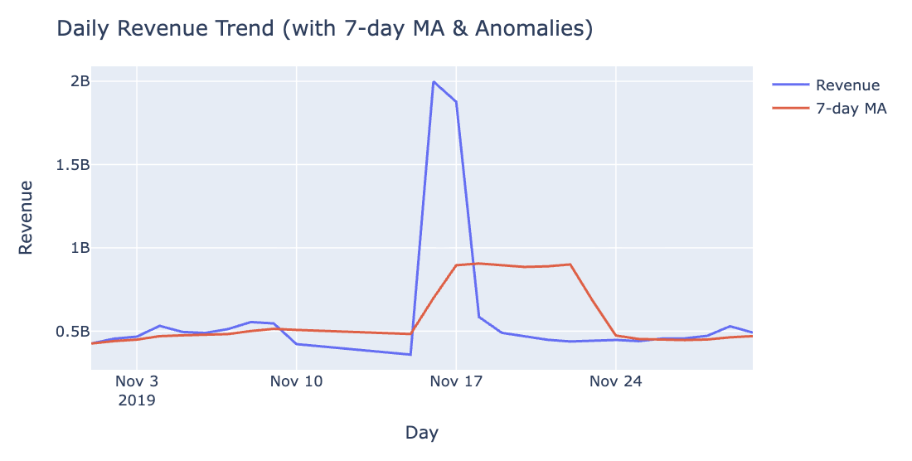
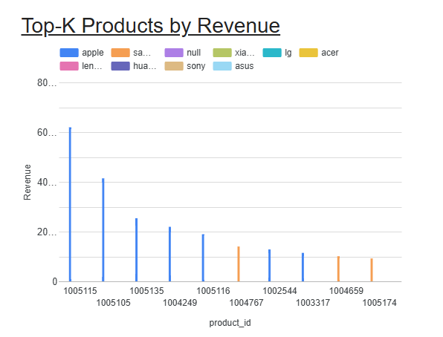
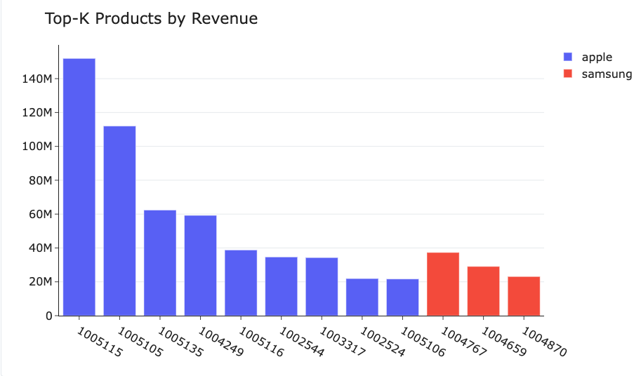
13
Results and Visualization of Query Performance
BigQuery
Databricks
648ms
761ms
760ms
780ms

Slide 14
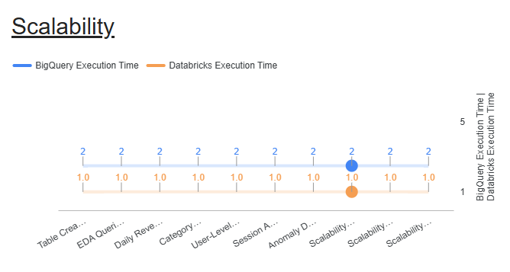
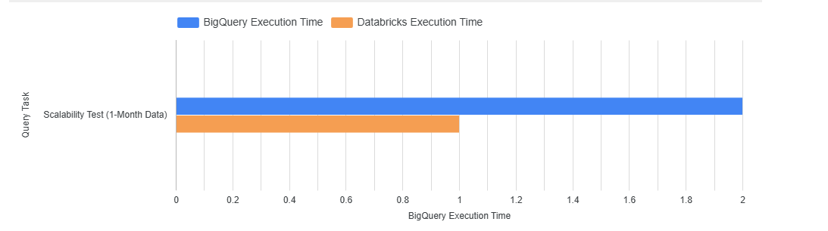
14
Results and Visualization of Query Performance

Slide 15
16
Conclusion – Which one is better?
BigQuery:
Serverless, auto-scaling, best for ad-hoc analytics and dashboards.
Databricks:
Cluster-based Spark engine, faster with in-memory caching.
Performance:
BigQuery consistent (~2 s); Databricks quicker on repeats (~1 s).
Trade-off:
BigQuery = simplicity, Databricks = flexibility & control.
Conclusion:
Both scale well ,choose BigQuery for ease, Databricks for iterative heavy analytics.
Thus, it depends on the use case!

Slide 16
14
17
Future Scope and Extensions
Predictive Modeling:
Incorporate machine learning tasks (e.g., predicting readmission) to evaluate Databricks' MLOps advantage.
Cost-Performance Analysis: Conduct a detailed cost breakdown on petabyte-scale datasets under different pricing tiers.
Multi-Cloud Comparison:
Extend the study to include analytics platforms like Snowflake or Azure Synapse for a broader industry benchmark.

Slide 17
18
References/Sources
Cloud Data Platforms & Documentation:
Google Cloud Big Query — SQL Reference
BigQuery Performance & Compute Optimisation — Best Practices
Databricks — Data Engineering Guide
Databricks — Compute Management
Apache Spark — SQL Window Functions Reference
Visualization & Reporting:
Google Looker Studio — Data Visualization Documentation
Databricks Visualization (Plotly) — Official Docs
Dataset Source:
E-Commerce Events Dataset (2019–2020): Public Kaggle Dataset

Slide 18

19
THANK YOU

